Slide 1
End-to-End Real Estate Data Engineering and Analytics Pipeline
BY: K. Pavan Kalyan

Slide 2
Table of Contents :
Introduction & Objective
Data Source & Collection
Data Cleaning & Preprocessing
Staging Layer – AWS S3
Data Transformation – Databricks
Data Warehousing – Snowflake
Orchestration – Apache Airflow
Business Intelligence – Power BI
Tech Stack Overview

Slide 3
Problem statement
This project presents a complete end-to-end real estate data pipeline built to extract, process, store, and analyze property listings from Hyderabad, India. The pipeline supports only batch time ingestion.
Objective
To design and implement a scalable, modular, and automated pipeline for real estate data.
Enable data-driven decision-making through rich insights and visualizations.
Streamline the flow from raw data collection to interactive BI dashboards.
Key Components
Web scraping from a major real estate platform (Housing.com)
Cloud-based storage, transformation, and warehousing
Automated orchestration using Airflow
Power BI for dynamic and real-time dashboarding

Slide 4
Key Focus Areas:
Scraping the Housing.com website for Data
Preprocessing the data using python
Store the preprocessed and structured data in AWS s3 Bucket.
Transform the data by using Databricks
Ingest the data into Star schema model in Snowflake
Orchestrate Everything using Airflow.
Visualize the Results in Power Bi.

Slide 5
Resource Requirement and Specifications
Datasets:
Realestate_ScrapedData.json
Requirements:
Airflow
AWS S3
Apify tool
Snowflake
Azure DataBricks
Power BI Desktop

Slide 6
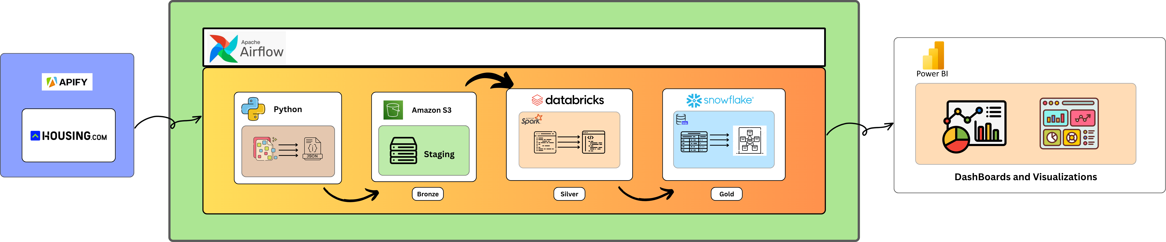
Project Architecture

Slide 7
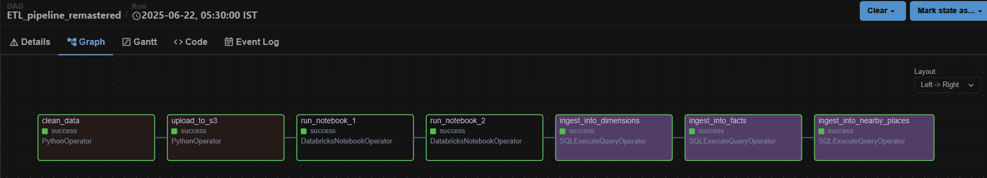
Flow Diagram

Slide 8
Flow Overview
Clean Data
Reads the scraped semi structured data and converts into required json format by considering important fields.
Upload_to_s3
Uploads the Preprocessed Json file to staging layer i.e, Aws s3 bucket.
Databricks Notebook (run_notebook_1)
Triggers the First notebook in databricks which is mounted to aws s3 bucket and creates 5 tables from the data and stores the tables in DBFS.
Databricks Notebook (run_notebook_2)
Triggers the Second notebook which takes the input from DBFS and applies the important transformations upon each table.
And directly writes the cleaned tables into snowflake using snowflake connector.
Ingest Into Tasks
Ingests the cleaned data into their respective tables in dimensional model.

Slide 9
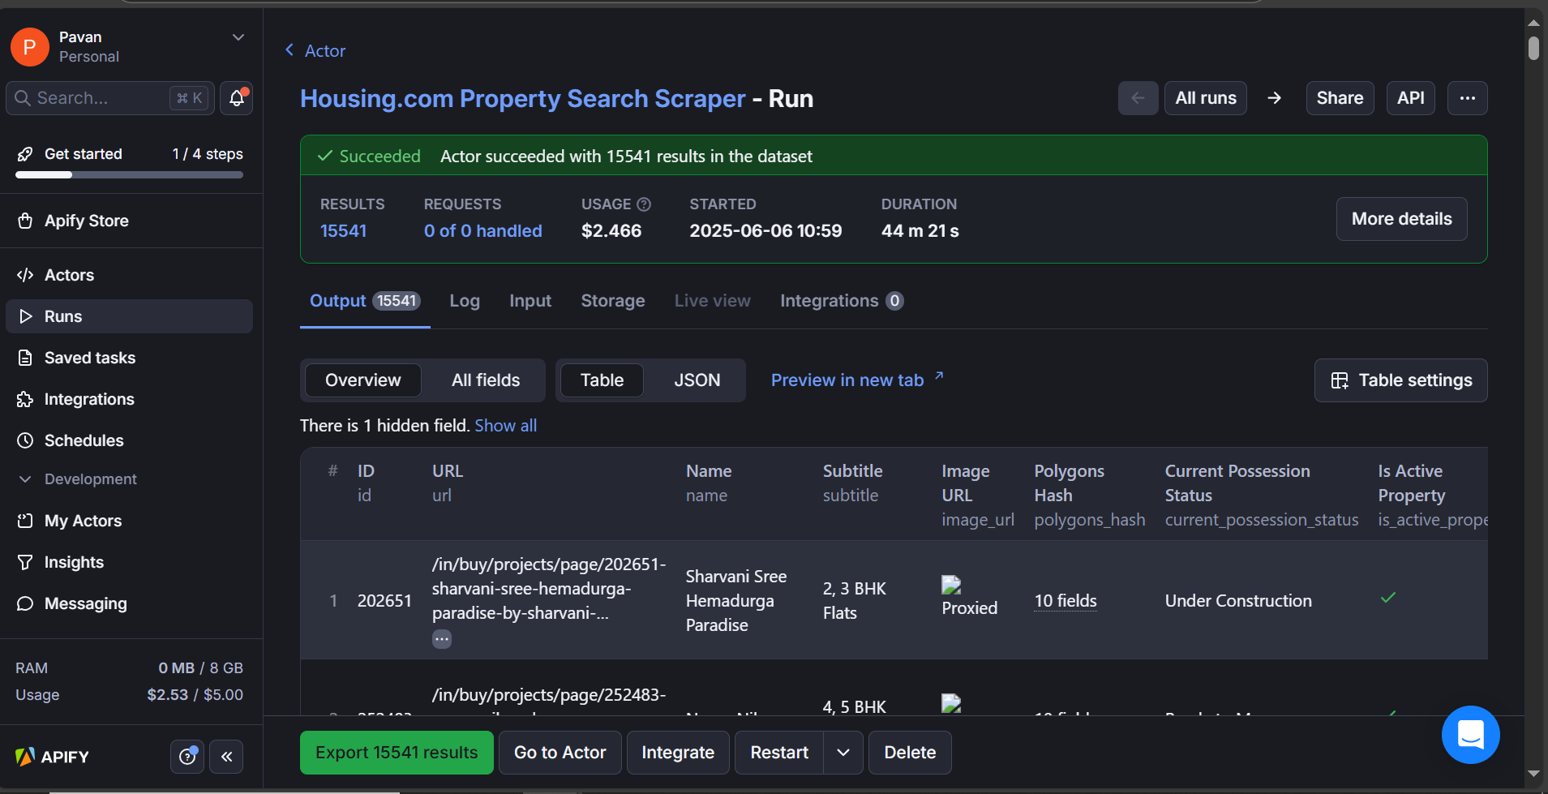
Data Collection

Slide 10
Databricks (Transformation and cleaning)
This phase involved transforming the staged JSON data into an analytics-ready format using distributed processing on Apache Spark via Databricks.​
Key Transformation Steps:​
Normalized configuration fields:​
Converted entries like "2 BHK" into structured columns (e.g., bedrooms = 2)​
Parsed composite fields:​
Extracted numeric values from fields such as price ranges and area dimensions​
Derived metrics:​
Calculated price per sqft, total area, and custom metrics used in dashboarding​
Flattened nested fields for amenity analysis while retaining original nested JSON for reference​
Enriched with tags such as locality category (premium/affordable), builder type (top-tier/local)​
Validation and Consistency Checks:​
Ensured no nulls in key analytical fields​
Checked for duplicates, invalid ranges, and outlier correction (e.g., unrealistic area/price)​
Output:​
Structured DataFrame with enriched and validated records​
Ready for ingestion into Snowflake (Gold Layer)​

Slide 11
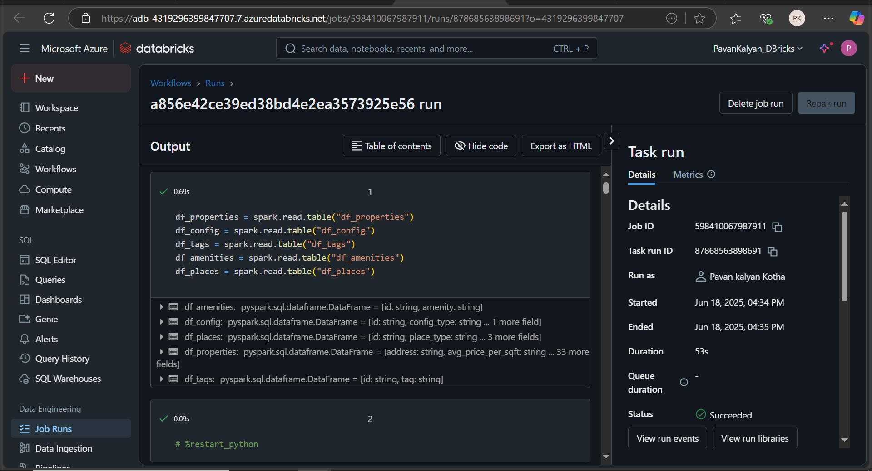
Notebook Sippets

Slide 12
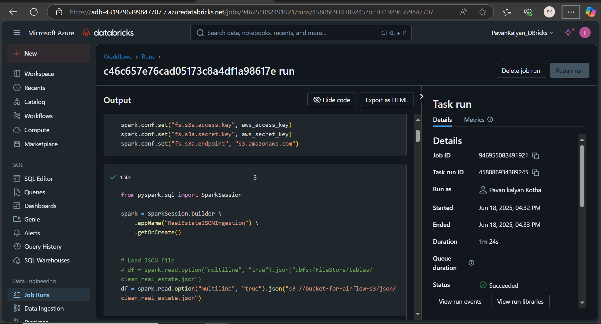
Notebook Sippets

Slide 13
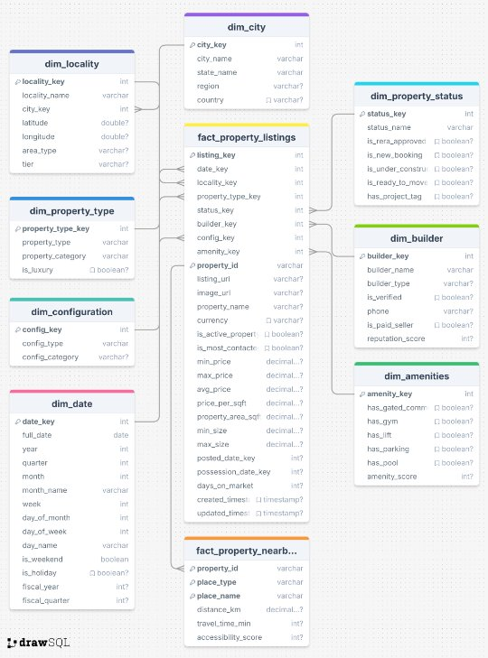
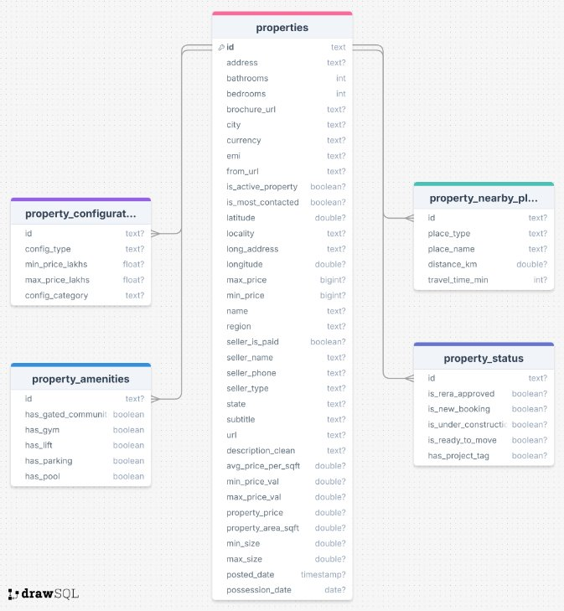
Database Schemas Diagram

Slide 14
Data Warehousing – Snowflake
Platform: Snowflake (Cloud Data Warehouse)
The transformed dataset from Databricks was loaded into Snowflake, forming the Gold Layer of the data pipeline to support analytics and dashboarding.
Star Schema Design
Fact Table: Property Listings Stores transactional attributes such as price, area, configuration, and timestamp.
Dimension Tables:
Location: City, locality, zone tags
Builder: Name, tier, reputation level
Configuration: BHK type, room count
Property Type: Apartment, Villa, Plot
Date: Listing and update timelines
Storage Format and Optimization Data was stored in columnar format, optimized for OLAP operations.

Slide 15
Orchestration – Apache Airflow
Tool: Apache Airflow
Airflow was used to orchestrate and automate the end-to-end data pipeline, ensuring seamless execution across all stages.
Workflow Automation Scheduled and managed tasks for:
Data cleaning with Python scripts
Uploading to AWS S3
Spark jobs on Databricks
Snowflake ingestion
DAG Design Defined modular and reusable DAGs with task dependencies to maintain logical execution flow and recoverability.
Monitoring & Logging Integrated task-level logs and alerting for failures or delays to ensure pipeline reliability.

Slide 16
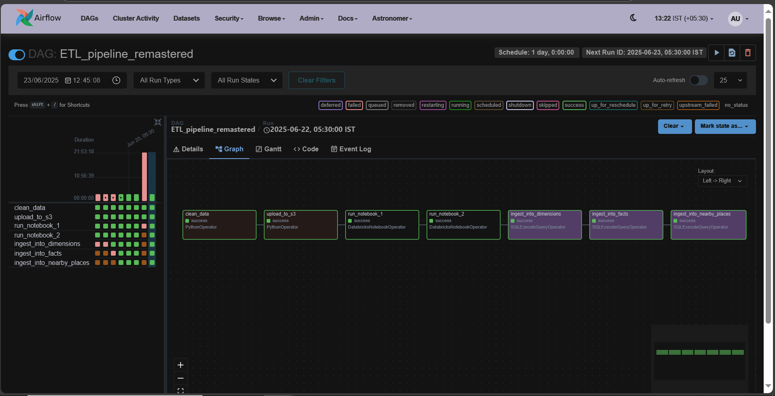
Apache Airflow UI

Slide 17
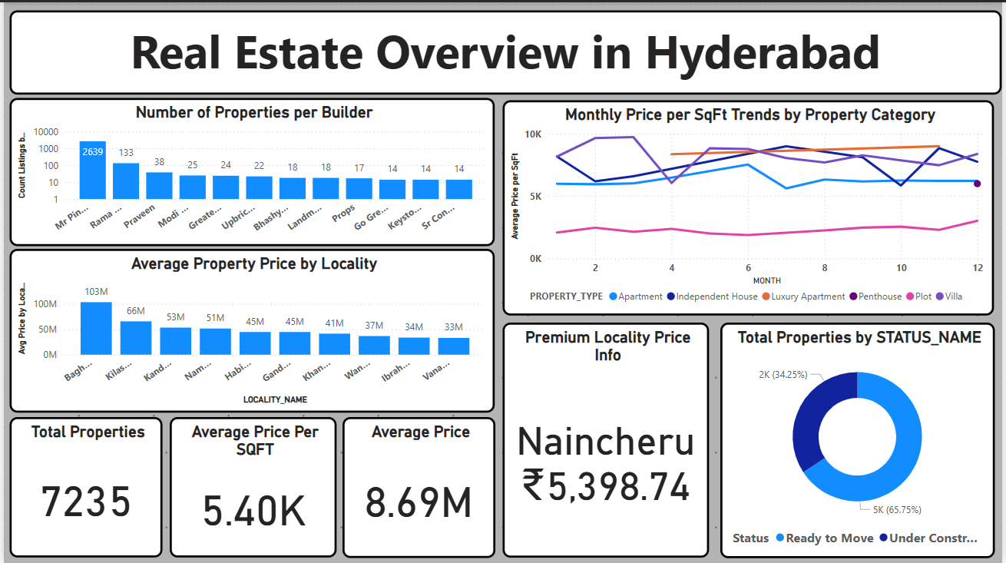
Power BI Visuals

Slide 18
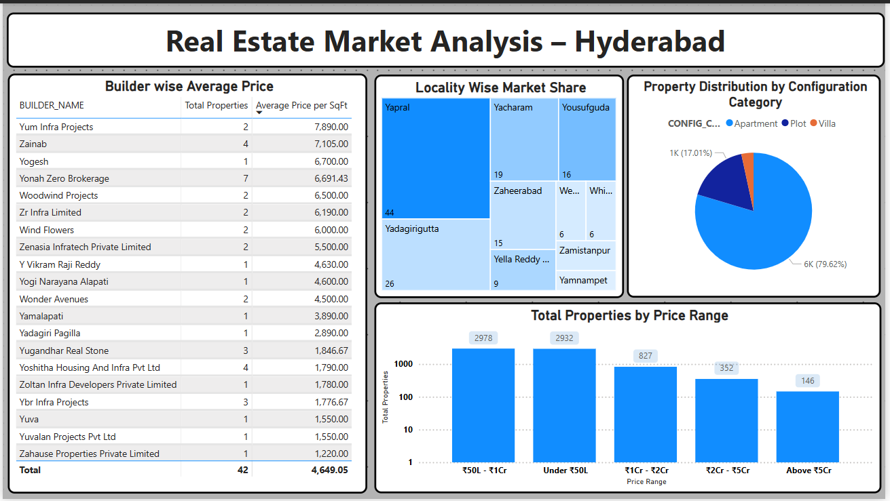
Power BI Visuals

Slide 19
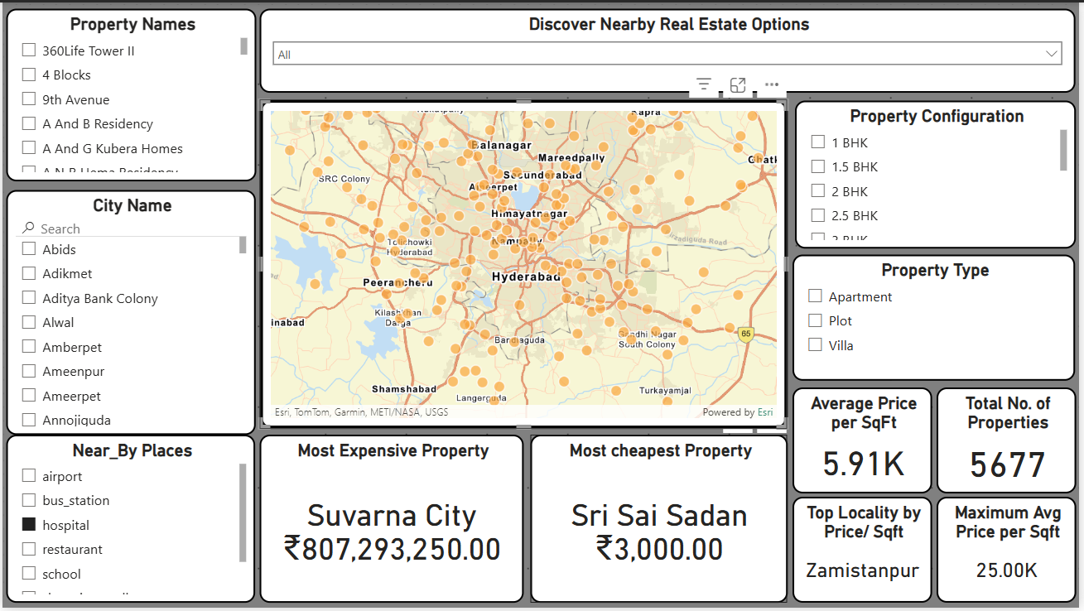
Power BI Visuals

Slide 20
References
• Microsoft Azure Documentation: https://learn.microsoft.com/en-us/azure
• Databricks Documentation: https://docs.databricks.com
• Snowflake Documentation: https://docs.snowflake.com
• Power BI Documentation: https://learn.microsoft.com/en-us/power-bi

Slide 21





www.anblicks.com
Pardhasaradhi.vemuri@gmail.com
Technology Partnerships

